Slide 1


A Intership Presentation on
“ONLINE SECURITY GUARD HIRING SYSTEM”
Prepared by
Mr. Golhar Pankaj Gorakshanath ROLL NO:3146
Mr. Hulule Aditya Nanasaheb ROLL NO:3152
Mr. Hulule Siddhant Gahininath ROLL NO:3153
Mr. Balsane Sairaj Ravindra ROLL NO:3113
Mr. Deshmukh Saurabh Sanjay ROLL NO:3130
Guided by:
MISS.POONAM SHIRODE
Academic Year- 2023-24
Department of Computer Engineering
Amrutvahini College of Engineering, Sangamner

Slide 2

Introduction
Welcome to the Online Security Guard Hiring System presentation.
In an era of increasing digital reliance, ensuring the safety and security of physical spaces remains a top priority.
Today, we introduce a revolutionary approach to streamline and enhance the process of hiring security guards through an Online Security Guard Hiring System.

Slide 3
Problem Statement:
The shift to an online security guard hiring system is driven by the shortcomings of traditional methods. Manual processes lack transparency and face communication challenges, necessitating an online solution for a more efficient and accessible hiring process.

Slide 4
Purpose
The "Online Security Guard Hiring System" project aims to update and improve security services by addressing challenges and inefficiencies. It focuses on:
Efficiency:
Transparency:
Decrease overhead of customer:

Slide 5

Objectives
Strengthen Security
Recruitment Process
Improve Candidate Experience
Diversity in Recruitment
Implement Training Integration
Monitor Performance Metrics
Promote Continuous Improvement

Slide 6
Stakeholders
Clients
Developers
Platform Administrators
Security Guard Providers
Security Guards

Slide 7
Requirement Analysis:
User Registration and Profiles
Report Monitoring
Software /hardware requirements
Scheduling and Calendar Integration
Security Measures

Slide 8




Services

Slide 9
Features
Analytics and Reporting
Mobile Compatibility
Security Measures
Form for applicant and customers
Support and Help Center
User Registration and Profiles
Application Submission
Rating and Reviews
Dashboard for Admin
Feedback Mechanism

Slide 10
Functional Requirements:
Profile Management
User Registration
Invoice Creation
maitain feedback
dashboard Updates

Slide 11
Advantages
Efficiency: Streamlines the hiring process, reducing manual effort and time required.
Global Reach: Enables recruitment from a wider geographical area, accessing a diverse pool of candidates.
Cost-Effective: Reduces traditional recruitment costs associated with physical infrastructure and paperwork.
Data Accuracy: Minimizes errors in candidate information through digital data entry and verification processes.
Accessibility: Allows candidates to apply from anywhere, increasing accessibility and convenience.

Slide 12
Future Scope
AI and Machine Learning Integration
Biometric Authentication
IoT Integration for Surveillance
Enhanced Cybersecurity Measures
Cross-Platform Compatibility
Collaboration with Security Tech Innovations
Automated Compliance Monitoring
Mobile Recruitment Apps
Enhanced User Experience with UX/UI Innovations

Slide 13
Benefits of Using the System
Efficiency
Quality Candidates
Save time and resources with automated processes and streamlined workflows
Access a larger talent pool and find the most qualified individuals for your requirements
Cost-Effectiveness
Security
Reduce hiring costs by eliminating intermediaries and unnecessary expenses.
Ensure the safety and reliability of your security team through thorough verification processes.

Slide 14
Current Challenges in Security Guard Hiring
Limited Reach
Traditional methods restrict access to a limited pool of potential candidates.
Time-Consuming
The manual screening process is slow and labor-intensive, wasting valuable resources.
Inconsistent Quality
Relying on word-of-mouth or third-party agencies leads to inconsistent results.
Lack of Transparency
Difficulty in tracking the progress of the hiring process and verifying credentials.

Slide 15
Conclusion
The "Online Security Guard Hiring System" aims to revolutionize security services by connecting agencies with skilled professionals through an advanced platform. Key features include user registration, Rating and Review, Mobile Compatibility. It sets new standards, emphasizing security and legal compliance. Future enhancements include AI and blockchain for an elevated user experience, contributing to the evolution of security services recruitment.

Slide 16
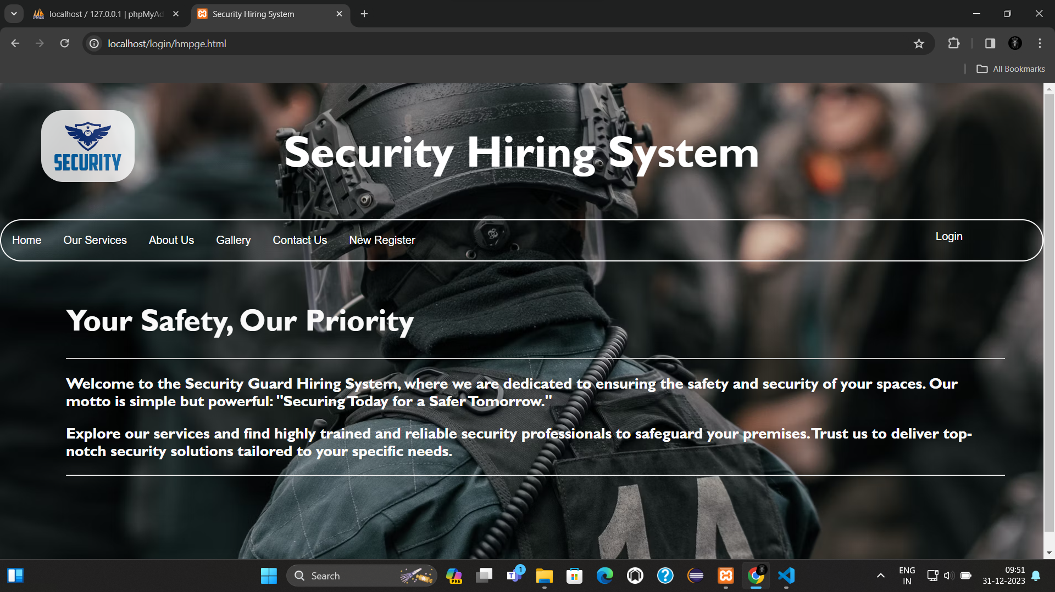

Slide 17
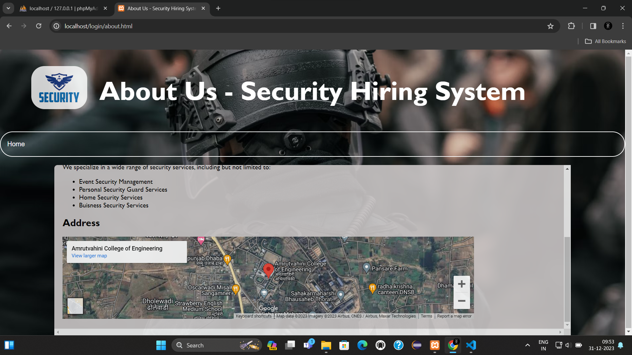
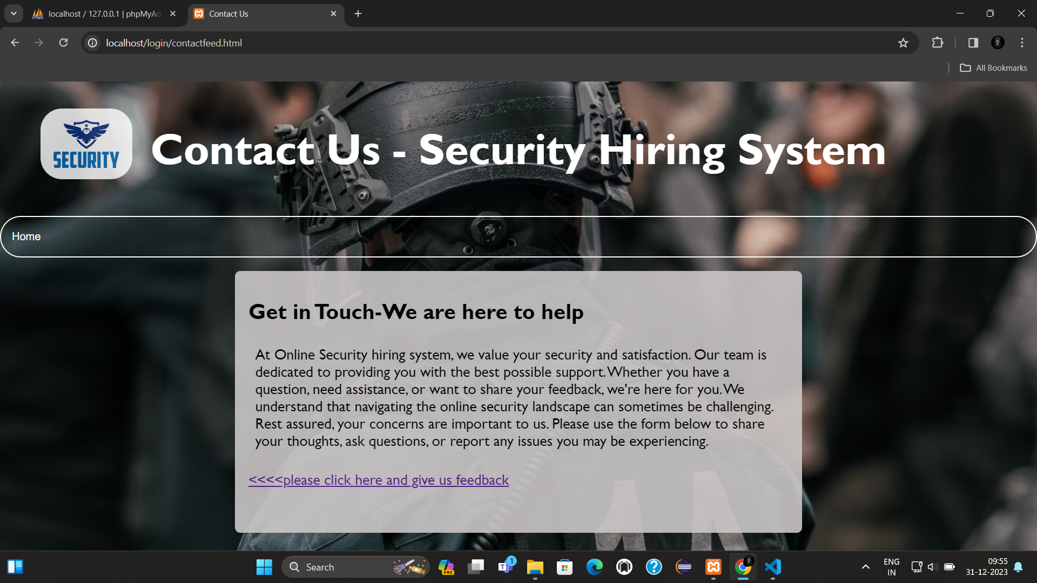

Slide 18
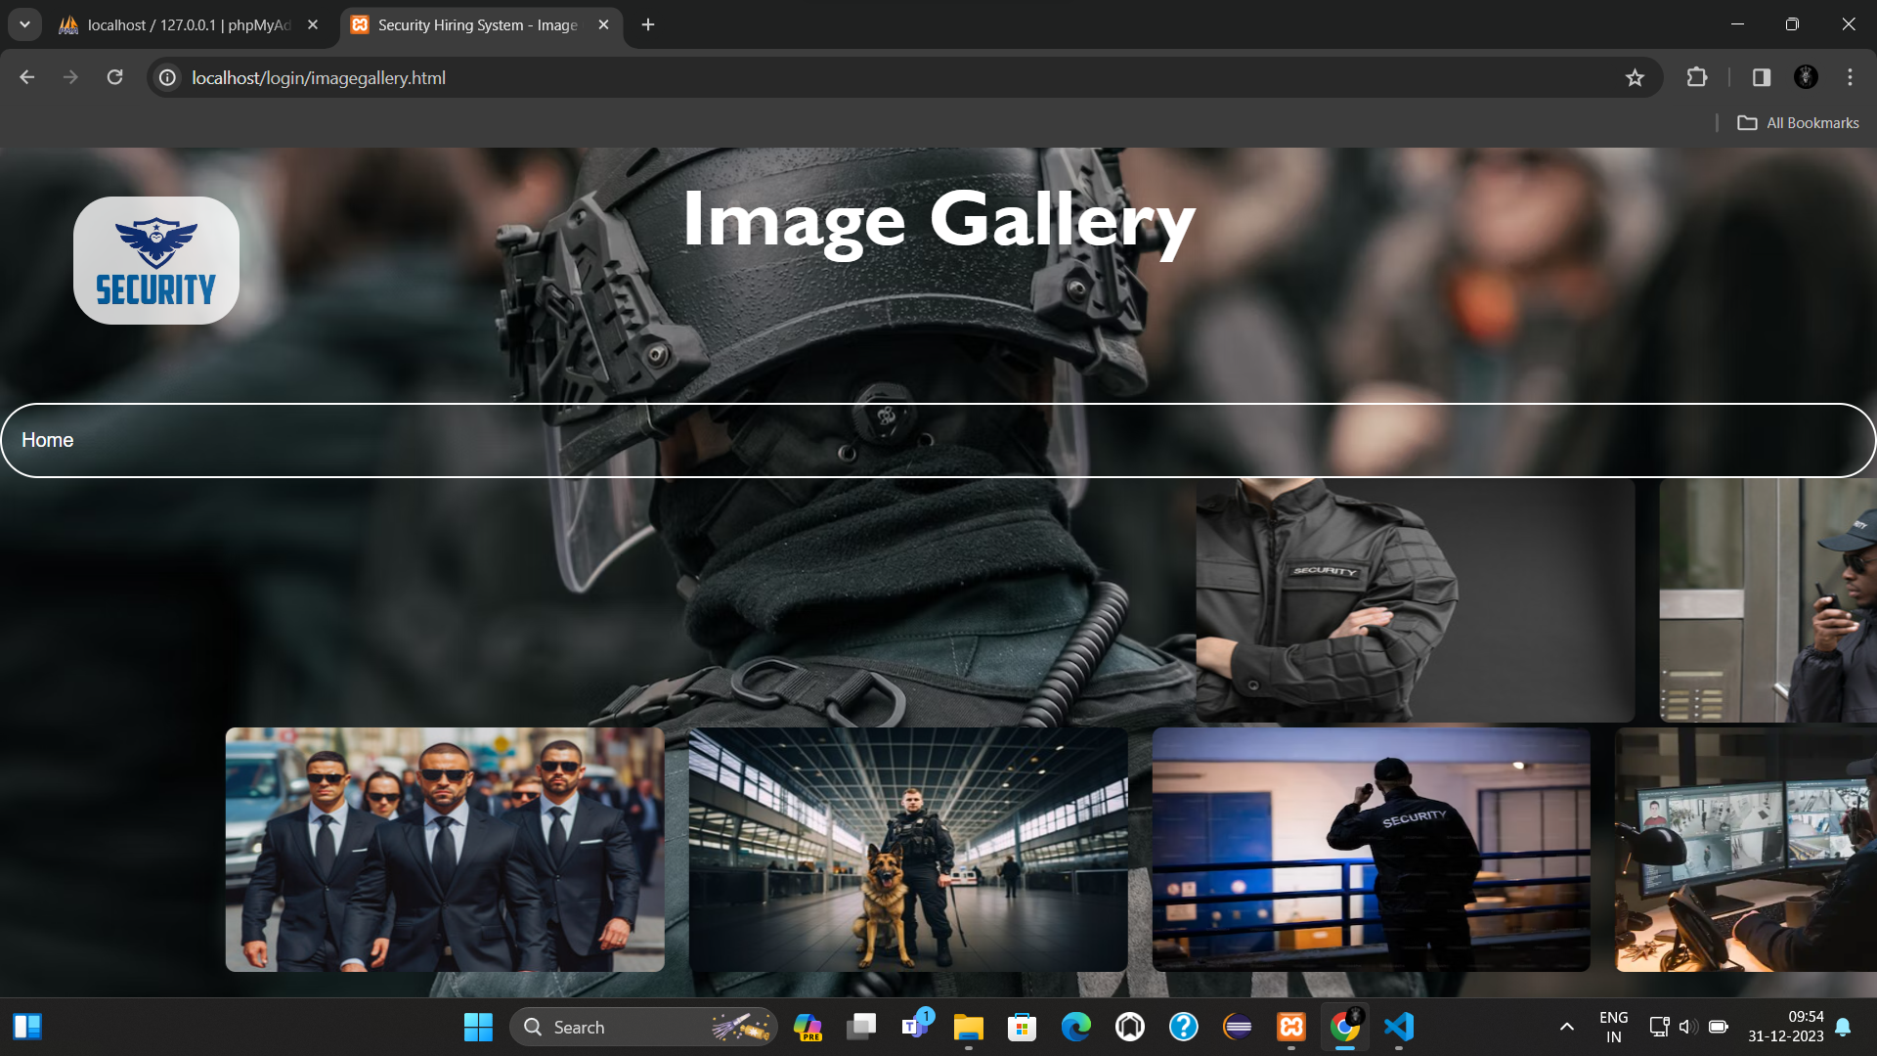
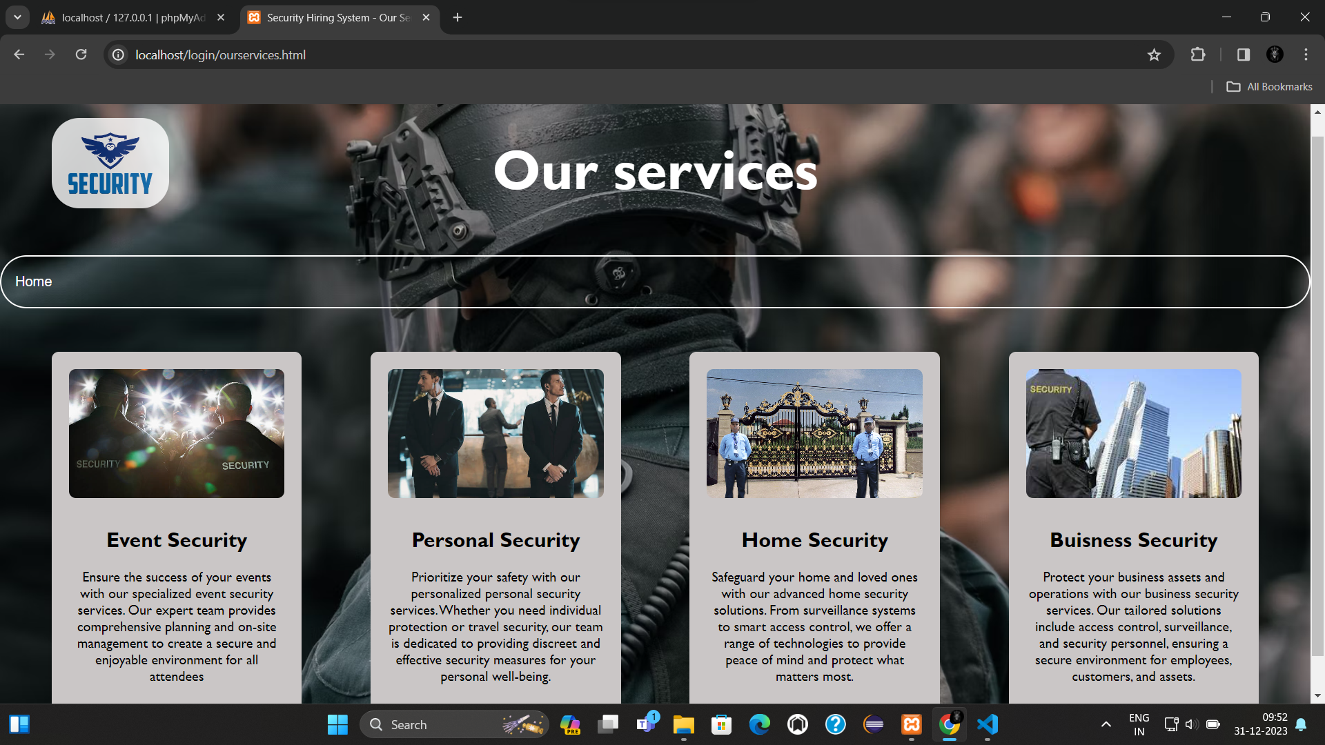

Slide 19
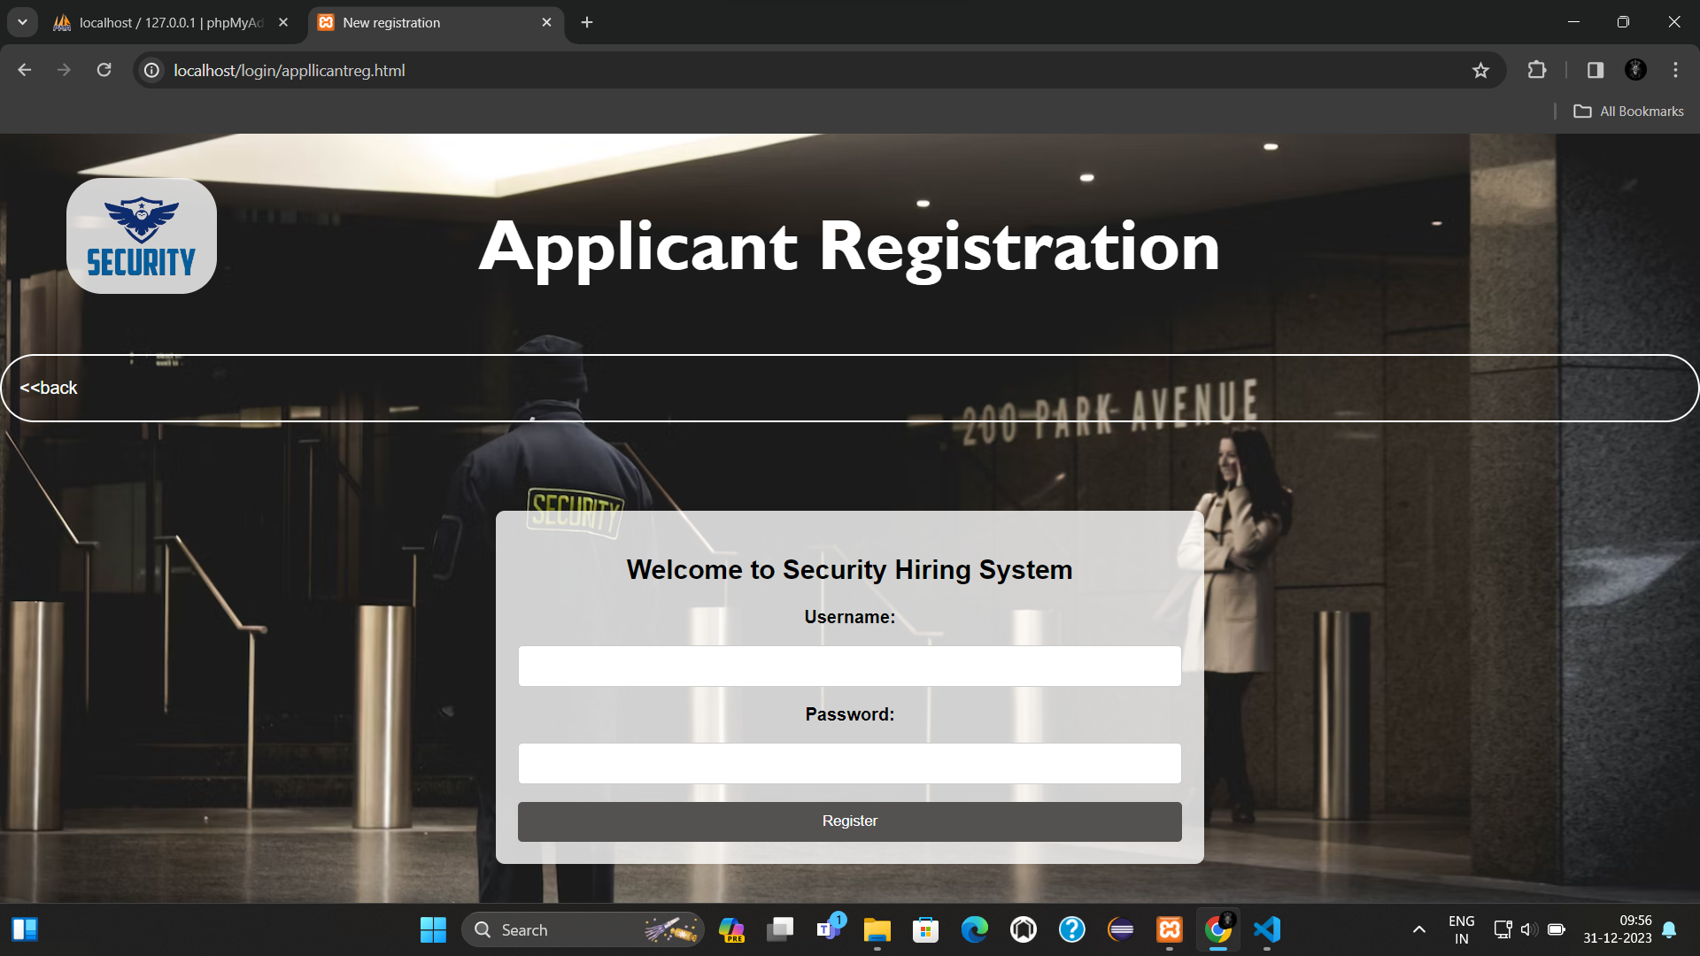
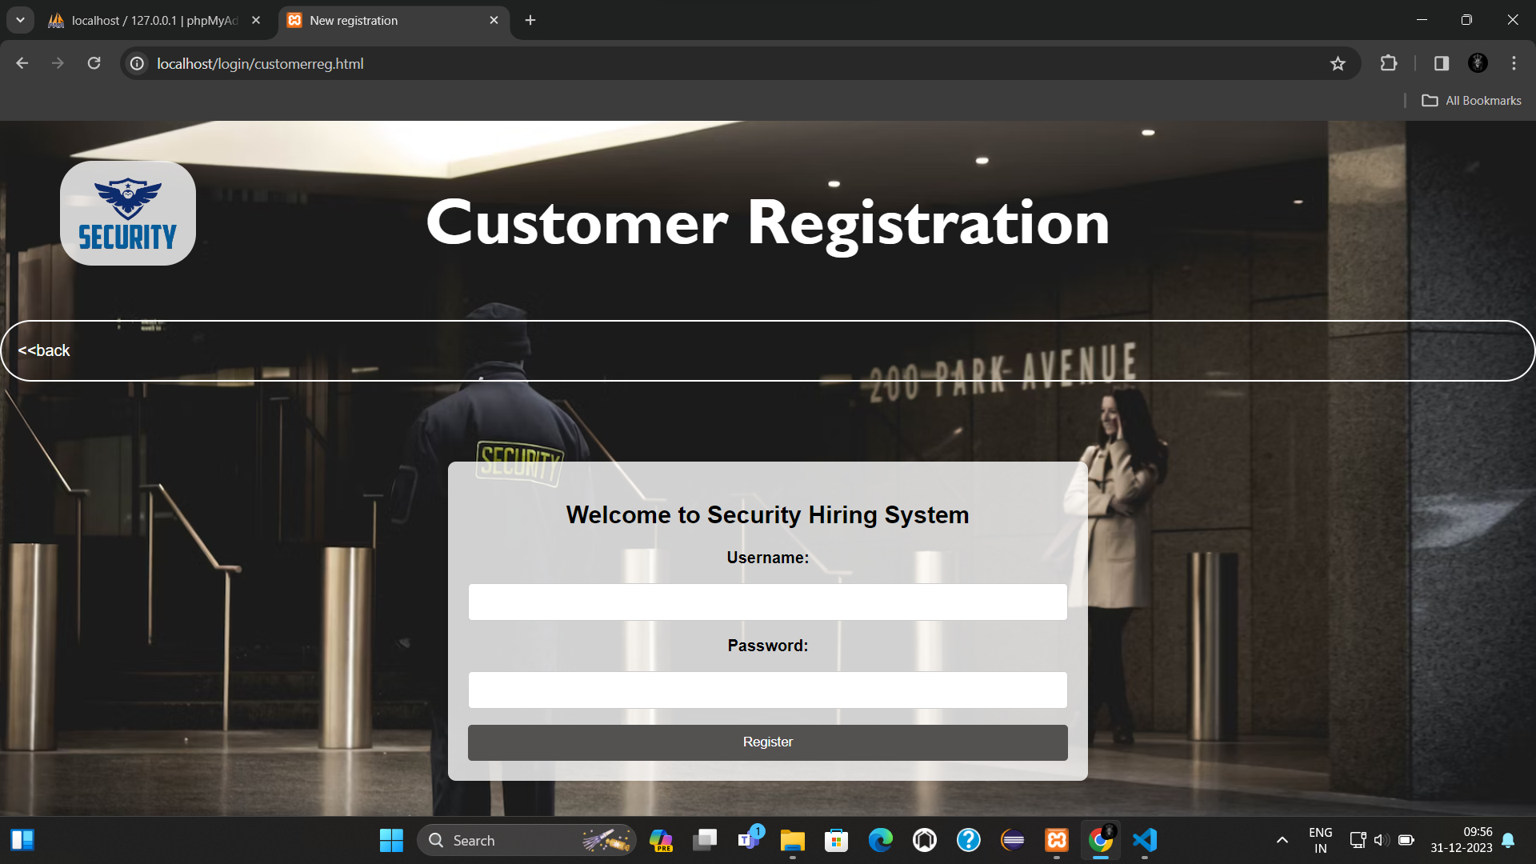

Slide 20
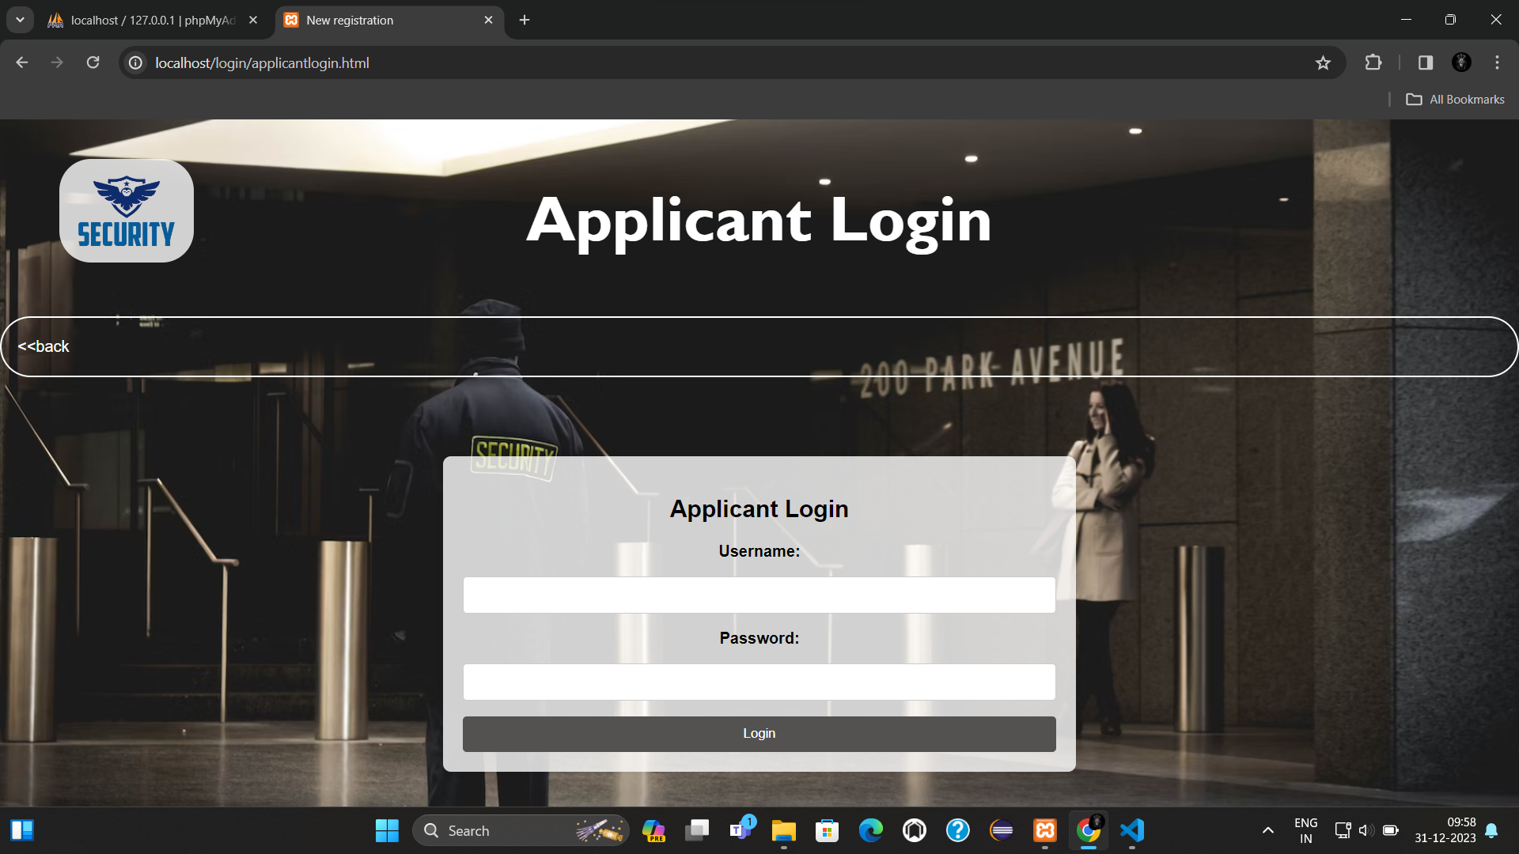
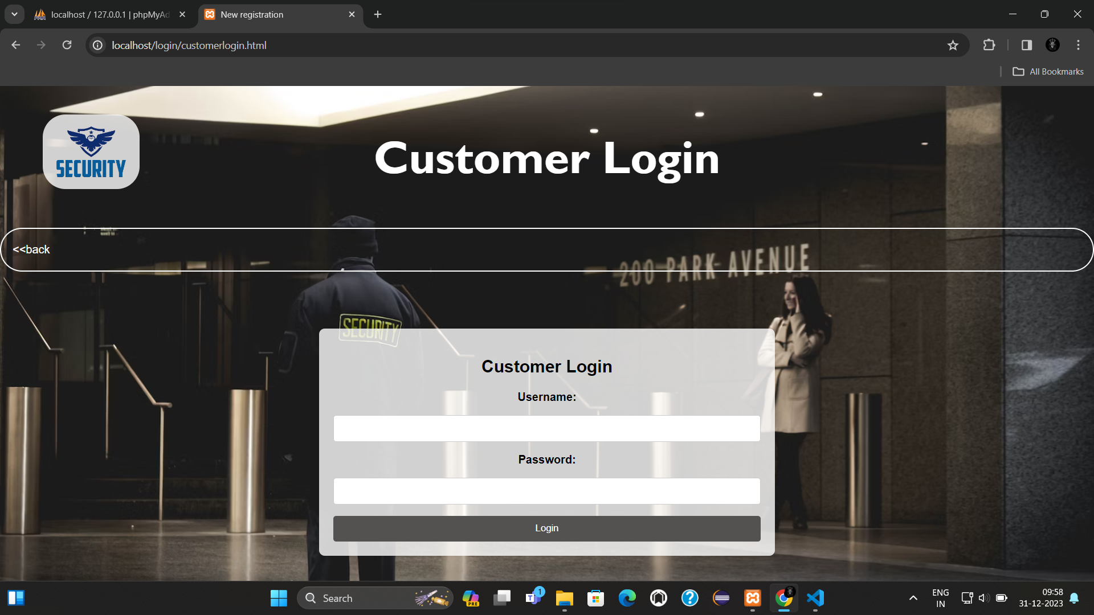

Slide 21
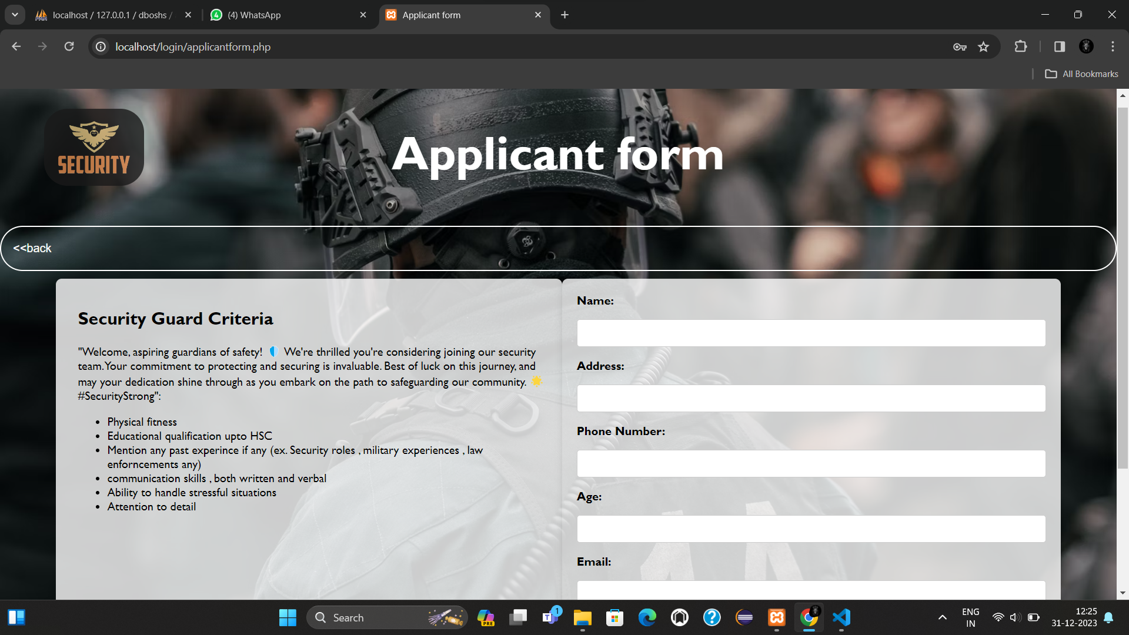
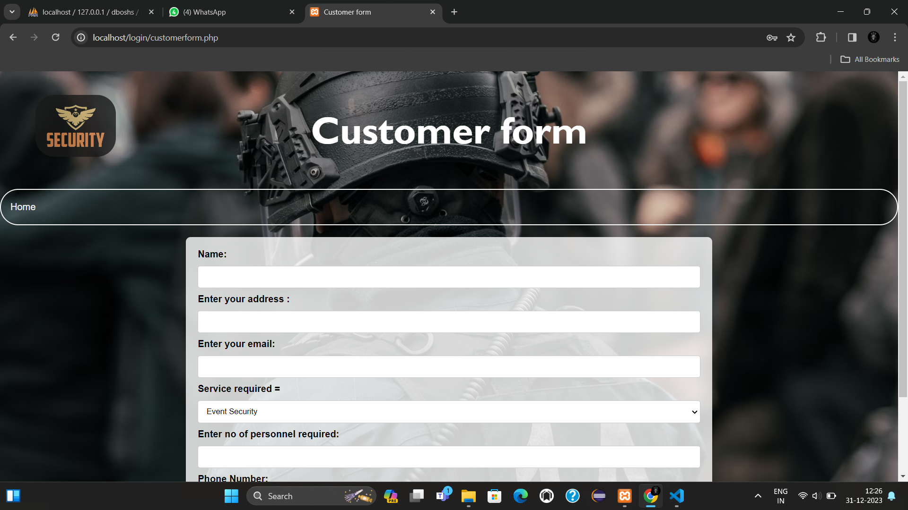

Slide 22
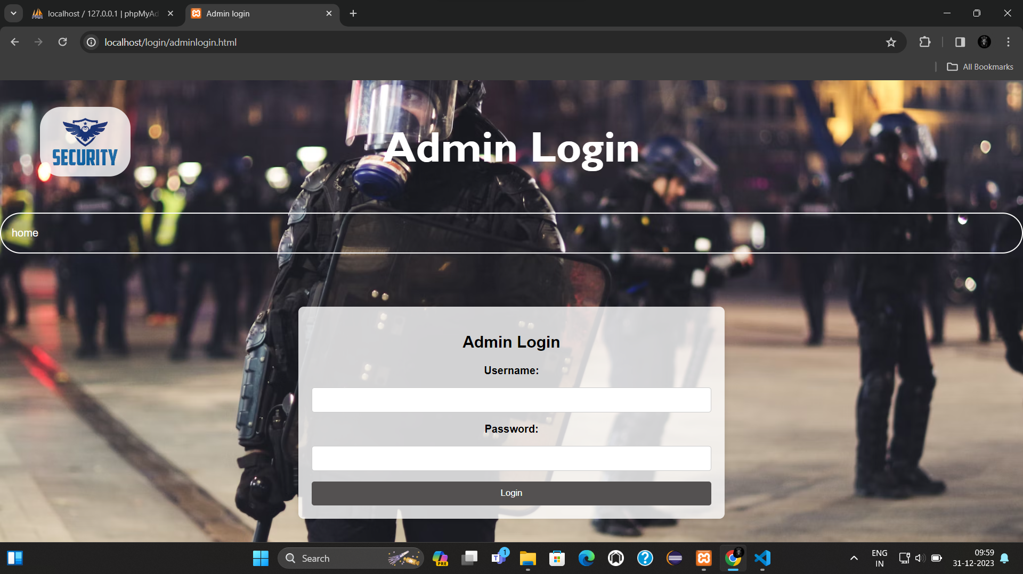

Slide 23
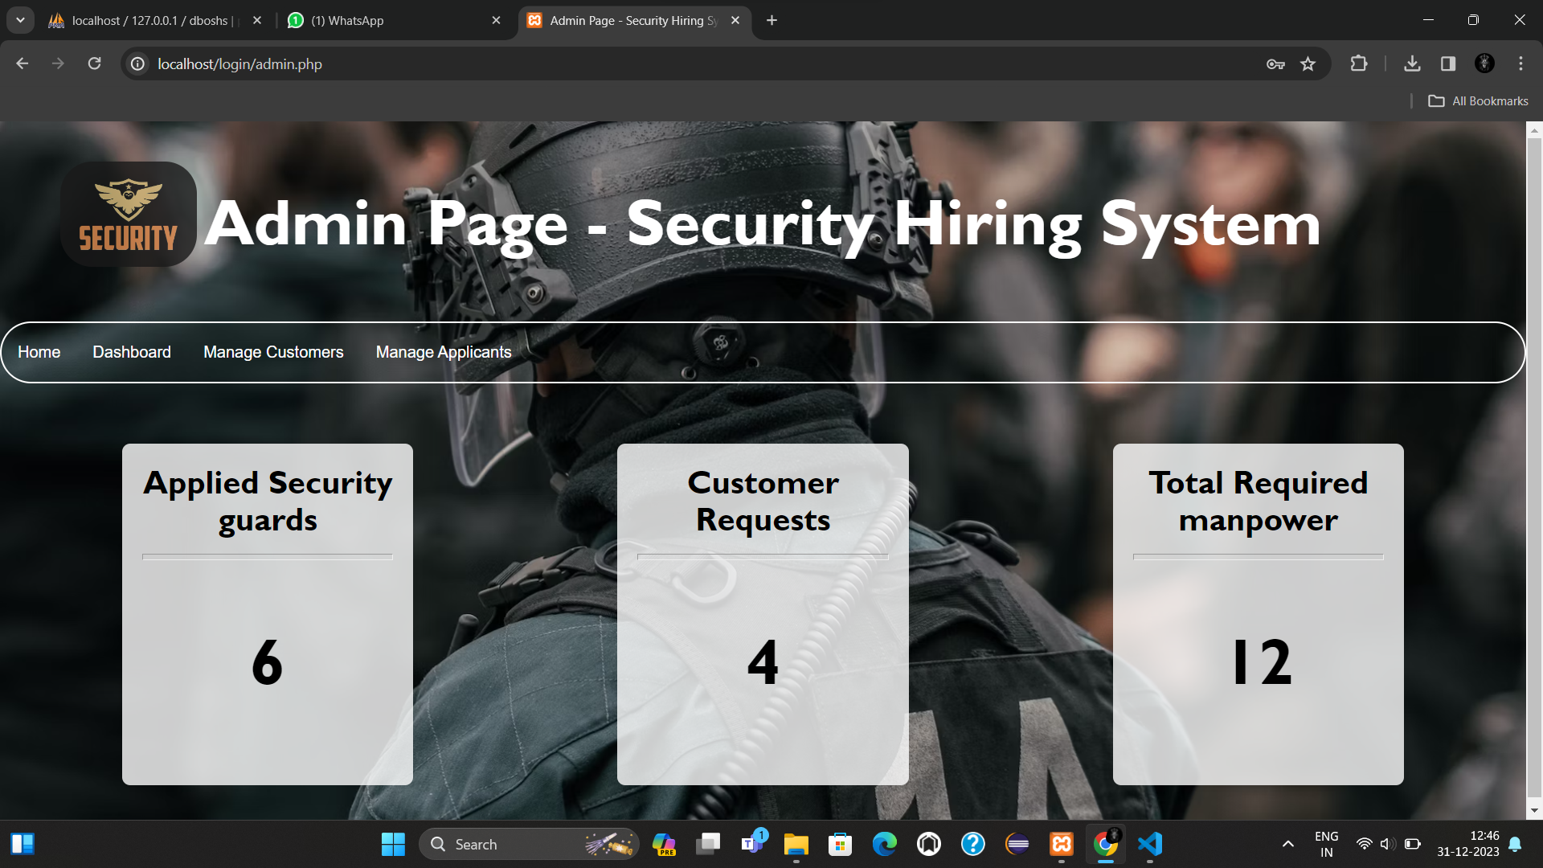

Slide 24
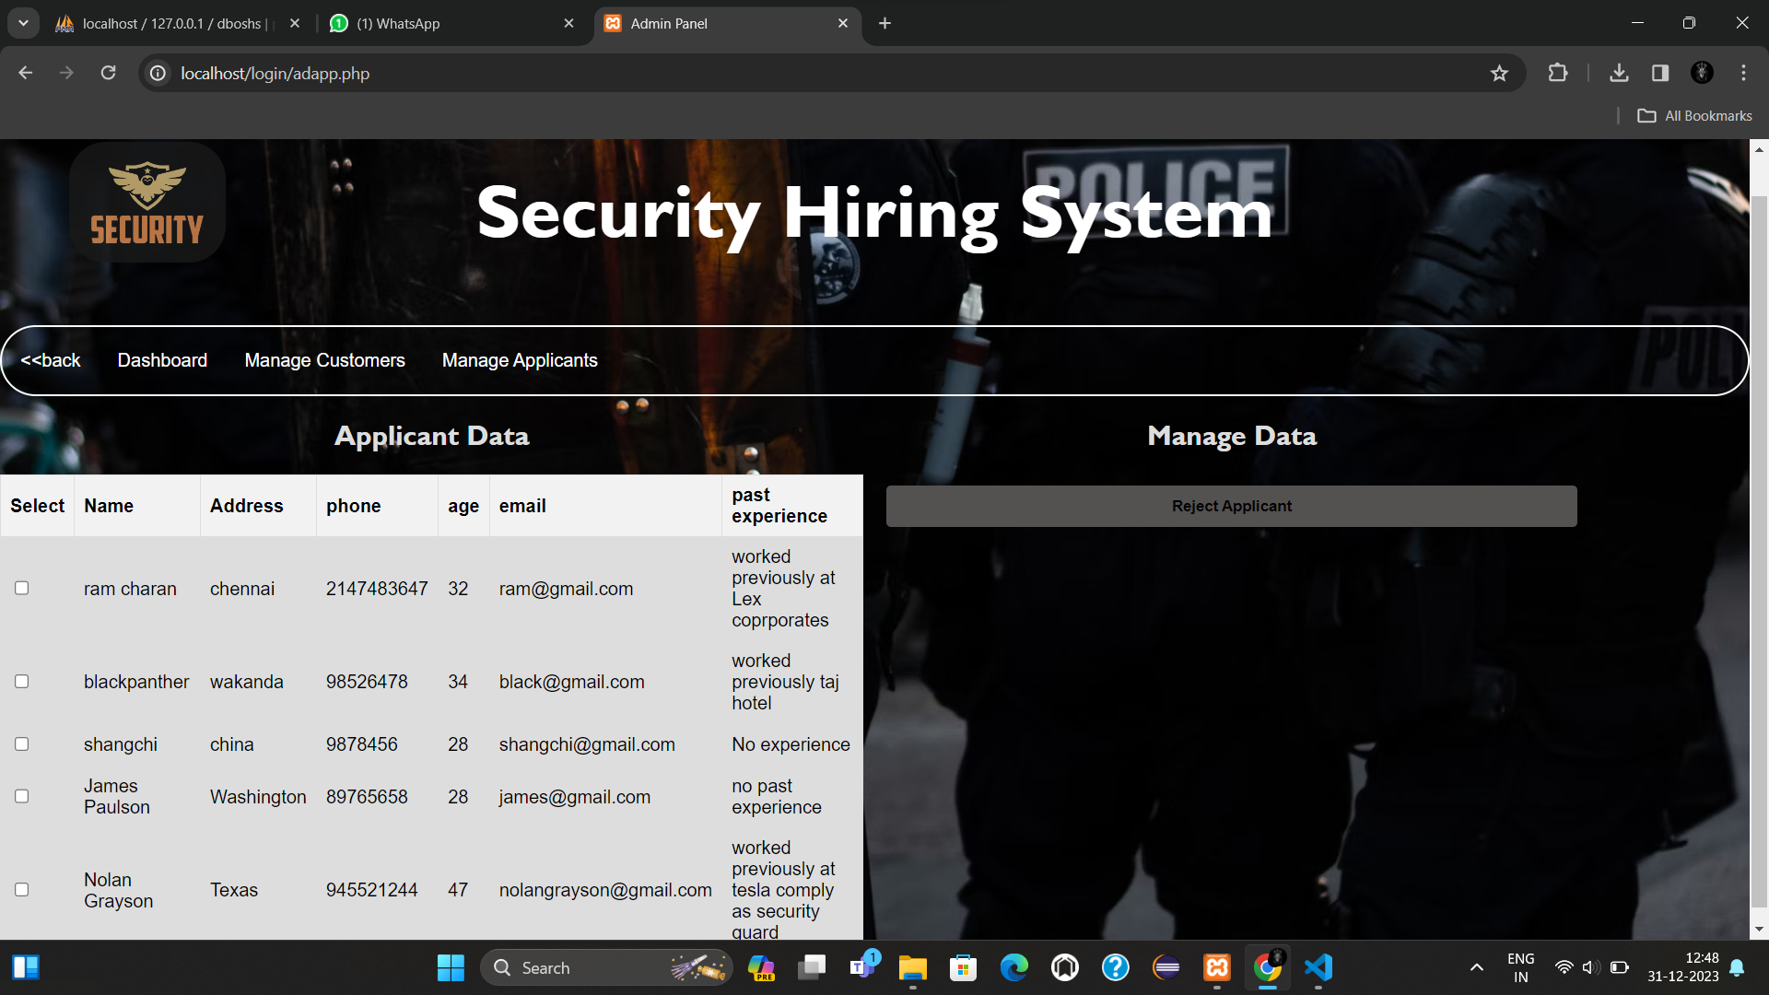

Slide 25
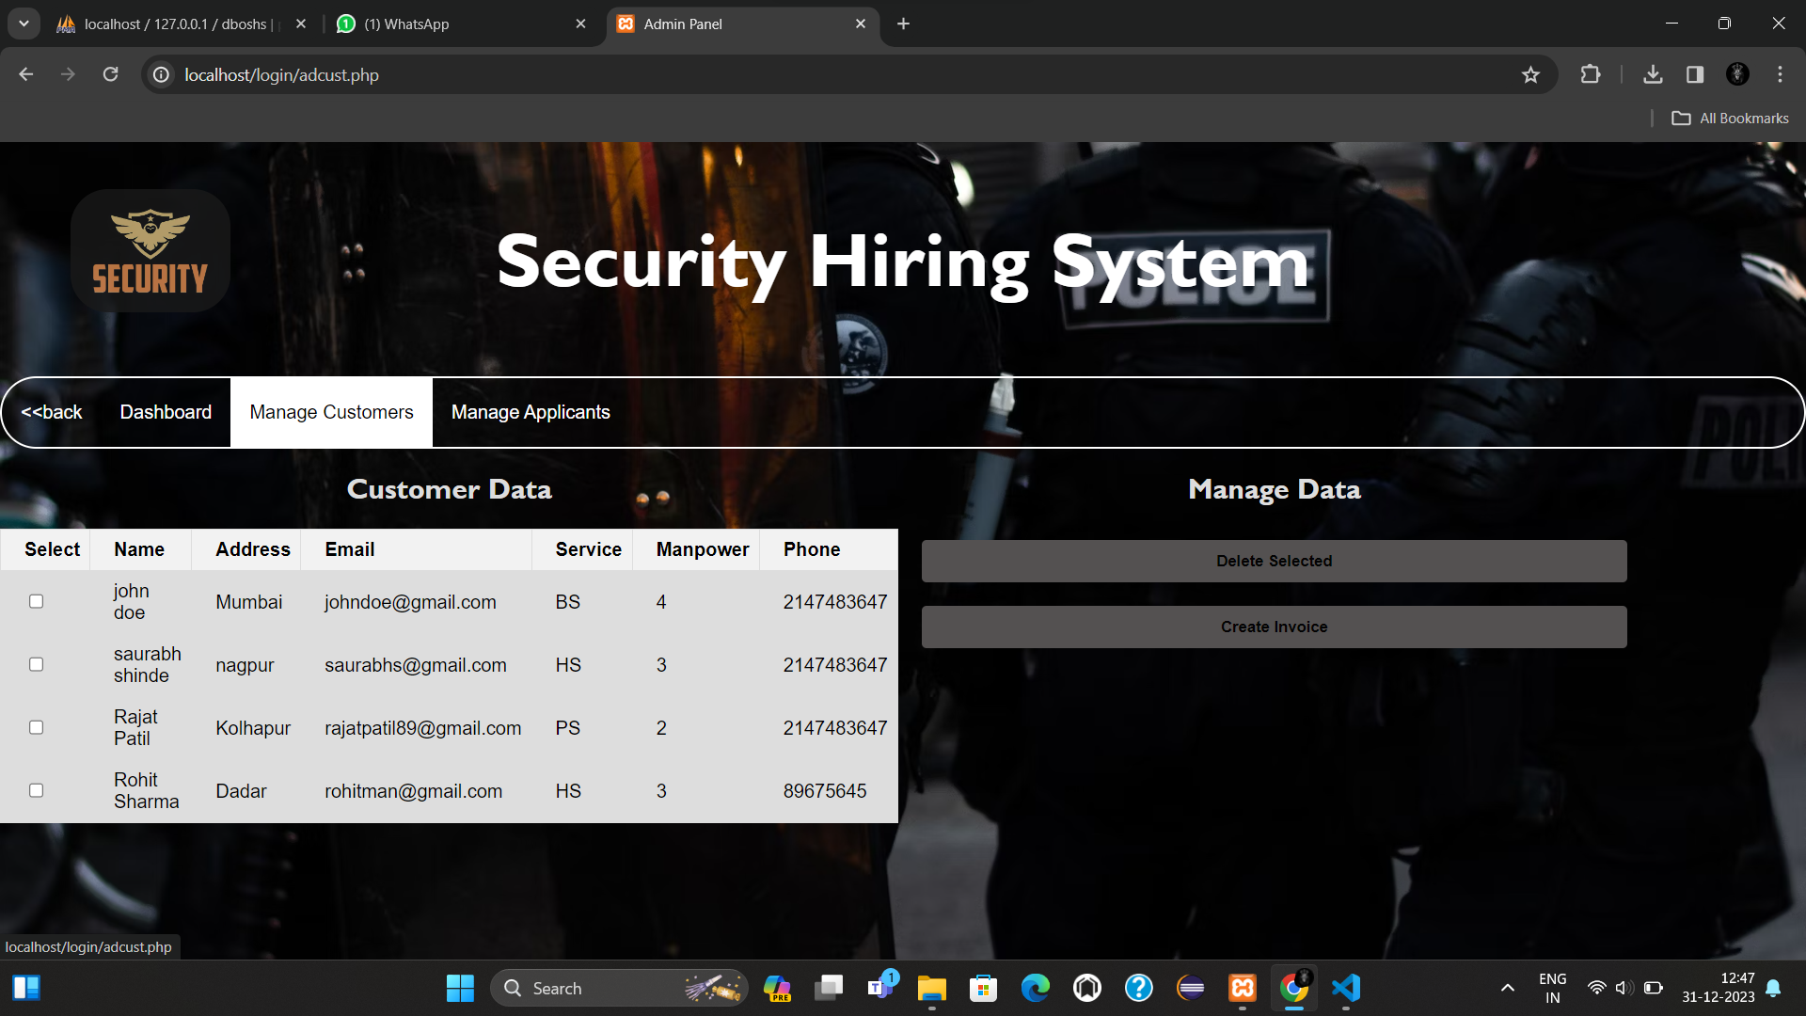

Slide 26
